Slide 1

Modern Control Theory
Lecture No. 17
A step-by-step Approach towards Derivation of the Kalman Filter in a Bayesian Framework

Slide 2

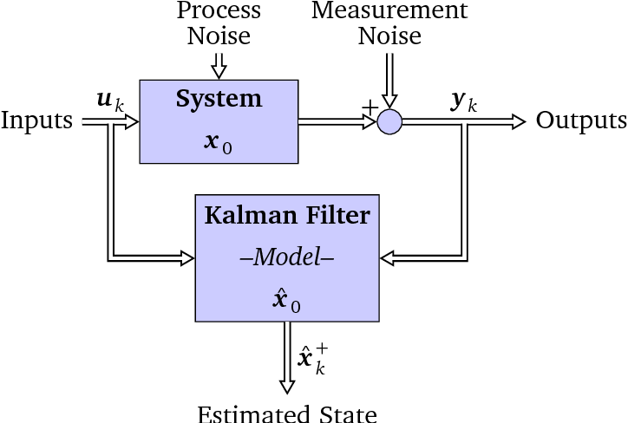
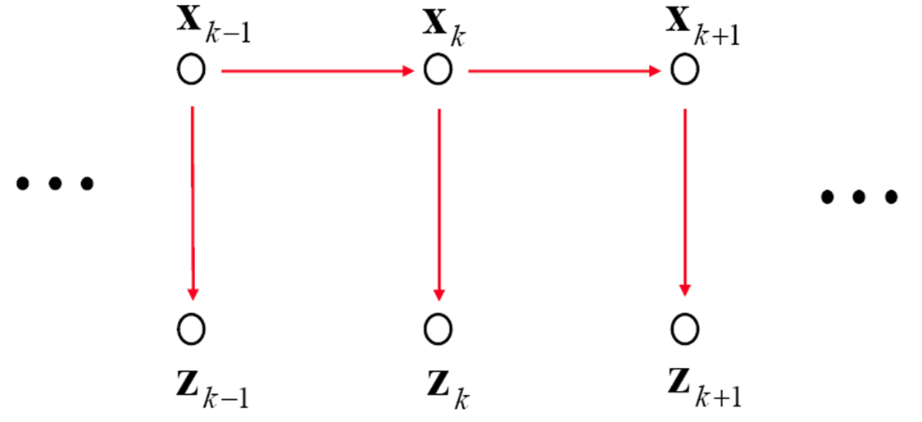

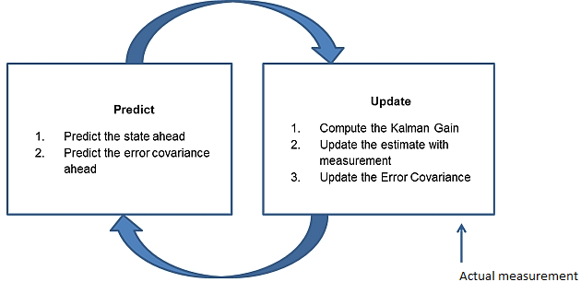
Recap --- Kalman Filter --- Prediction & Update

Slide 3
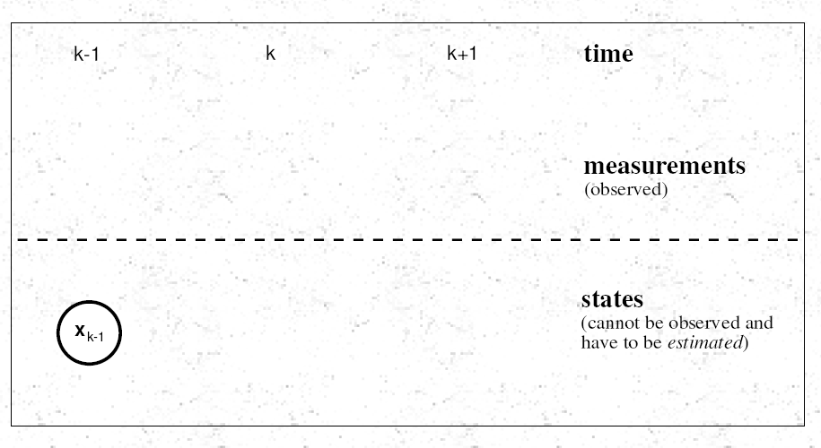
Propagating from (k-1) to (k) to (k+1)

Slide 4
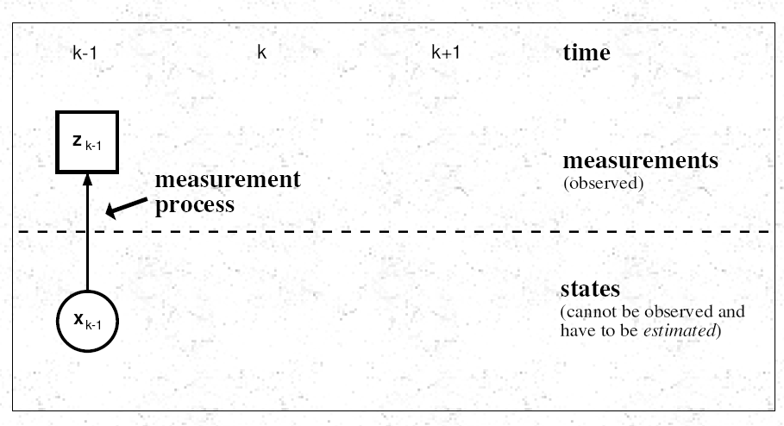

Slide 5
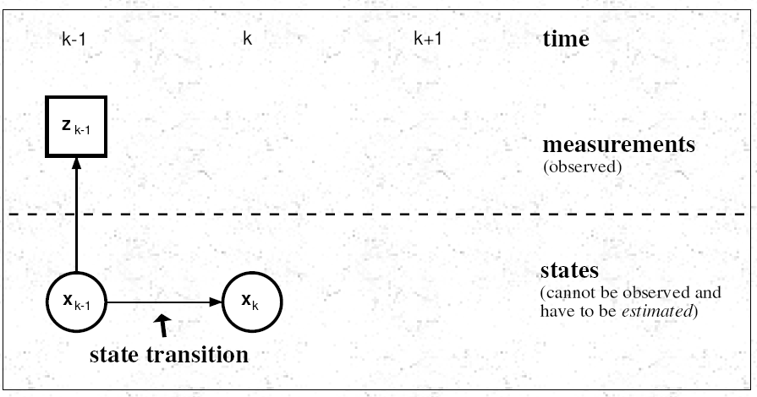

Slide 6
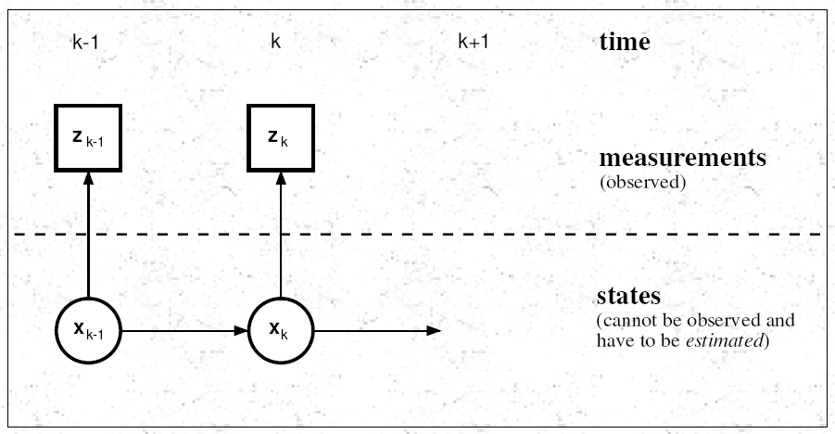

Slide 7
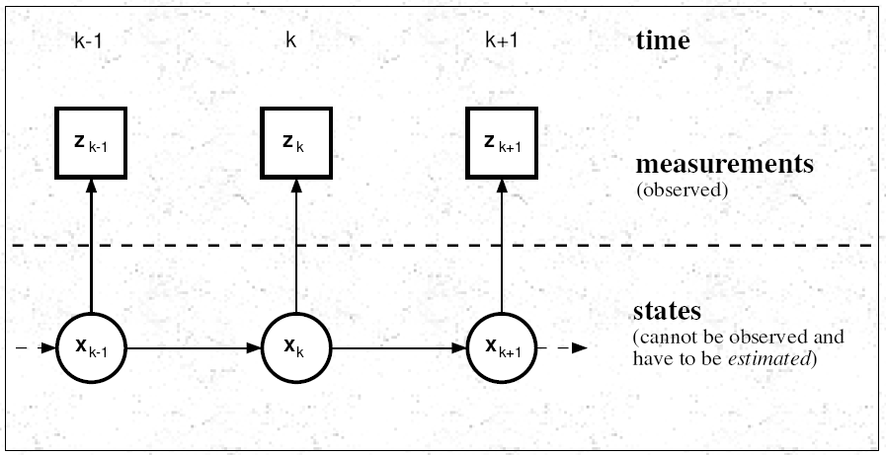

Slide 8
Components in a Bayesian Approach
State Vector : x_{k}
Measurement Vector: z_{k}
Initial pdf: p(x₀)
Likelihood pdf: (from model) p(z_{k}|x_{k})
Prior pdf: p(x_{k}|z_{1:k-1})
Posterior pdf: p(x_{k}|z_{1:k} )

Slide 9


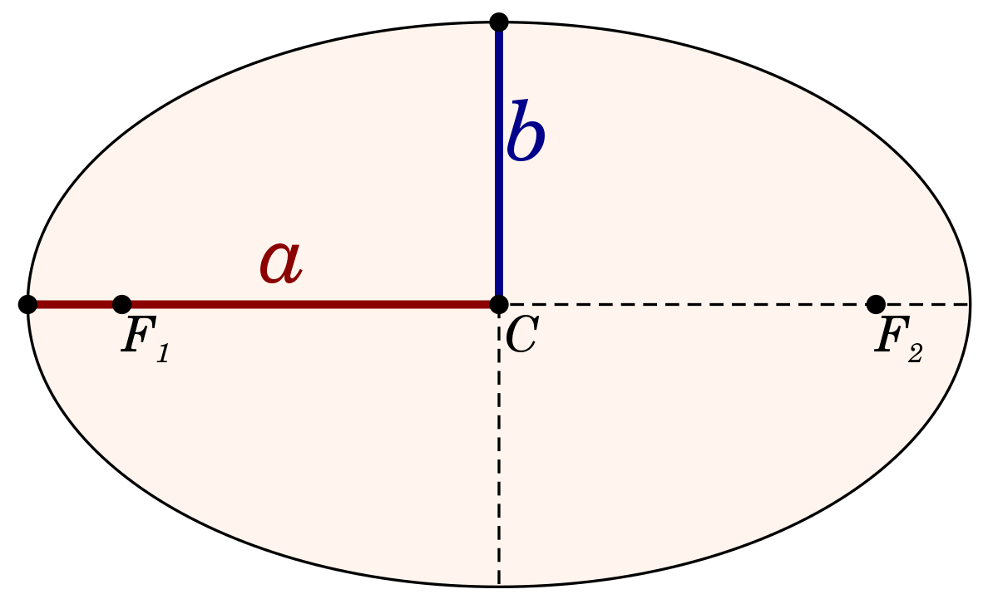
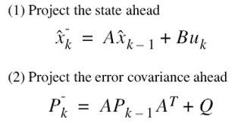




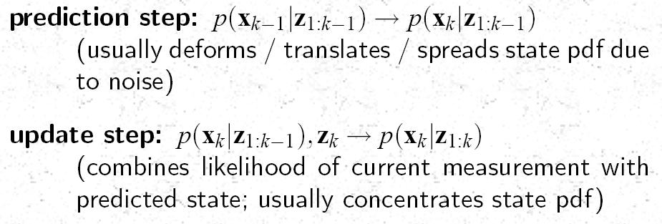
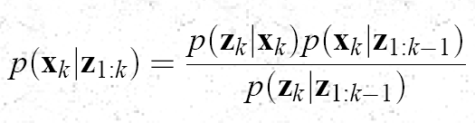
Review ---Kalman Filter --- The Bayesian Behavior
update step
(k-1)+
(k)-
(k)+
prediction step
k-1
k
z(k-1)
z(k)

Slide 10







Computing the Mean & Covariance of the “Prior” Function
Update
(k-1)+
(k)-
(k)+
Prediction
k-1
k
z(k-1)
z(k)

Slide 11




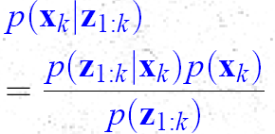
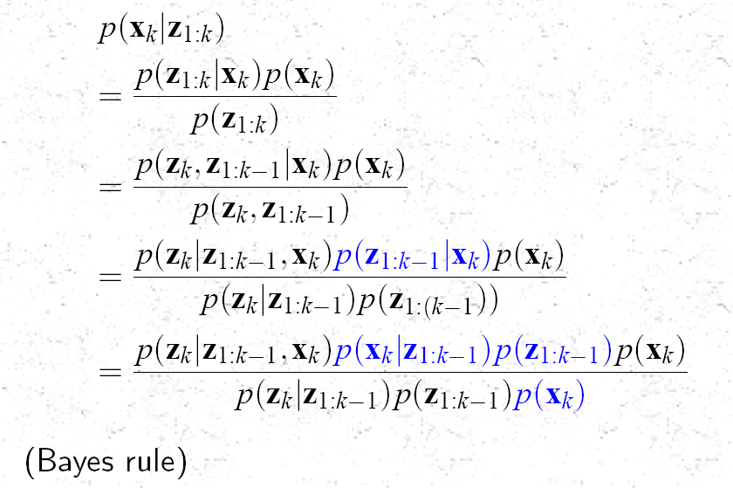
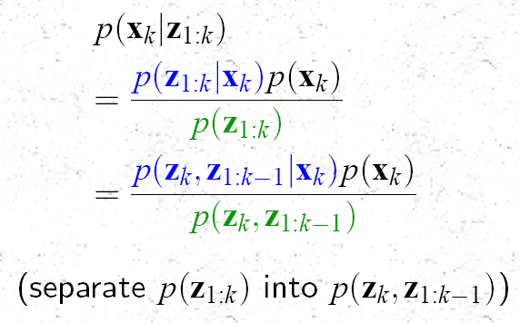

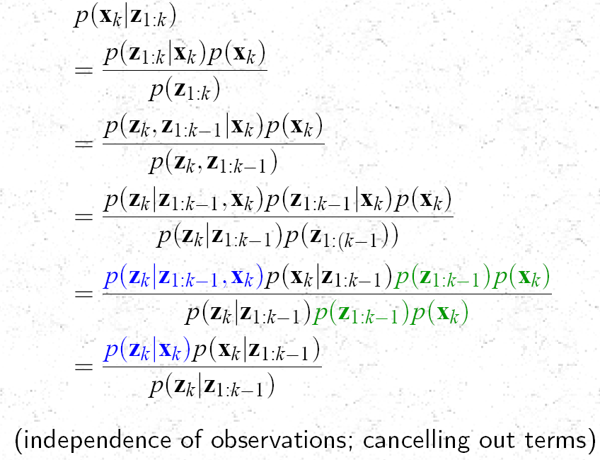
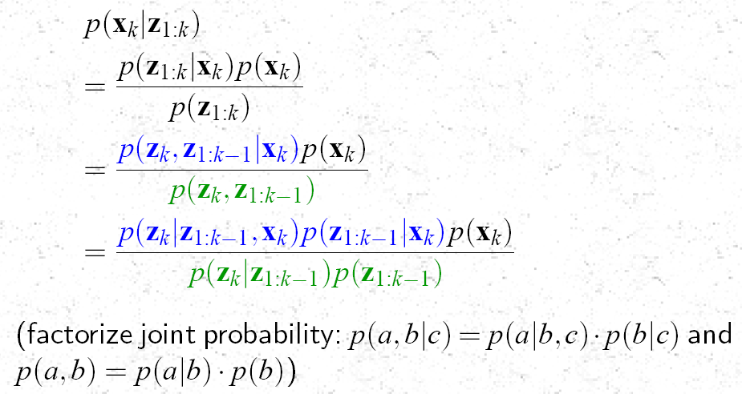
The “Posterior” Function
The Prior Function
Bayes’ Theorem
Update
Prediction
(k-1)+
(k)-
(k)+
k-1
k
z(k-1)
z(k)
To Show that Each
Term is
Gaussian

Slide 12
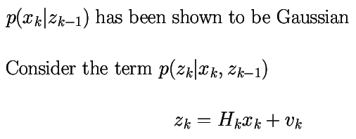
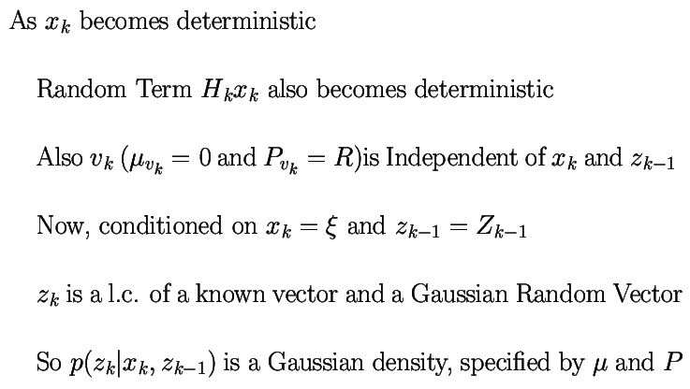
Gaussianity of the Likelihood

Slide 13
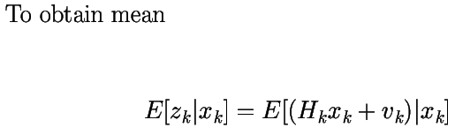


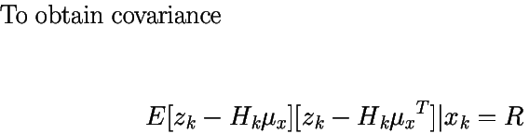


Mean & Covariance of the Likelihood

Slide 14
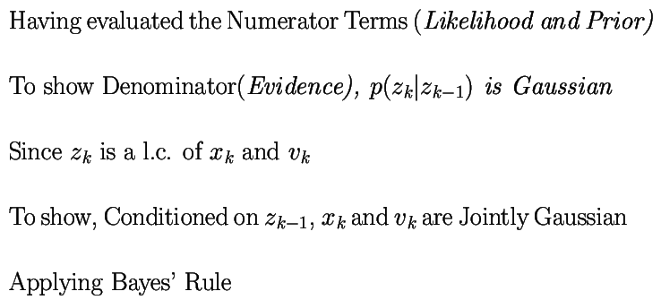

Gaussianity of the Evidence (denominator)
Since each RHS term is
Gaussian, the product is also
Gaussian

Slide 15
Step-by-Step Derivation of the Bayesian Posterior --- Expanding Slide # 10
Update
(k-1)+
Prediction
(k)-
(k)+
k-1
k
z(k-1)
To Show that Each
Term is
Gaussian
z(k)

